Slide 1
WordPress Course
Outline
Instructor Name: Nshimiyimana Christophe
Location : On-Site, Makuza Peace Plaza
Duration: 8 weeks
Introduction to WordPress
Website : www.tsindamedia.com
Tel : +250 798 873 226

Slide 2
Course Overview
Objective: Equip students with the skills needed to create, customize, and manage websites using WordPress.
Key Topics Covered:
1. Introduction to WordPress
2. Installing and Setting Up WordPress
3. Working with Themes and Plugins
4. Customizing WordPress Sites
5. Managing Content
6. SEO and Performance Optimization

Slide 3
Why Learn WordPress?
Importance:
Powers over 40% of all websites globally.
Versatile platform suitable for blogs, e-commerce, portfolios, and more.
Career Opportunities:
WordPress Developer
Web Designer
Content Manager
Digital Marketer

Slide 4
Module 1: Introduction to WordPress
What is WordPress?
Definition: WordPress is a content management system (CMS) that allows users to create and manage websites without needing extensive coding knowledge.
Types of WordPress:
WordPress.com: Hosted version with limited customization.
WordPress.org: Self-hosted version offering full control and customization.
Benefits of WordPress:
1.User-friendly interface
2. Extensive plugin ecosystem
3. Highly customizable

Slide 5
Understanding WordPress Dashboard
Overview of the Dashboard:
Navigation Menu
Posts and Pages Management
Media Library
Settings and Tools
Customization Options:
Personalizing the dashboard
Adding shortcuts and widgets

Slide 6
Hands-On Practice: WordPress Dashboard
Task: Explore the WordPress dashboard, customize the interface, and familiarize yourself with the key sections.

Slide 7
Module 2: Installing and Setting
Up WordPress
Setting Up WordPress Locally vs. Online
Local Installation: Using tools like XAMPP or WAMP for local development.
Web Hosting: Choosing a hosting provider, setting up a domain, and installing WordPress.
Pros and Cons:
Local: No internet required, good for testing.
Online: Real-world environment, accessible from anywhere.

Slide 8
Installing WordPress on
a Web Host
One-Click Install: Using hosting providers like Bluehost, SiteGround, etc.
Manual Installation: Downloading WordPress, uploading via FTP, and setting up a database.
Configuring Basic Settings:
Site title and tagline
Permalinks
General, reading, and discussion settings

Slide 9
Hands-On Practice: WordPress Installation
Task: Install WordPress on your local machine or hosting account and configure the basic settings.

Slide 10
y.
Module 3: Working with
Themes and Plugins
Choosing the Right Theme
Free vs. Premium Themes:
Free: Limited features but good for beginners.
Premium: More features, support, and customization options.
Popular Themes:
Astra, OceanWP, Divi, Flatsome
Installing and Activating Themes:
Searching for themes in the WordPress repository
Uploading and installing themes manually

Slide 11
Customizing Themes
Using the WordPress Customizer:
Changing site identity (logo, site title)
Adjusting colors, fonts, and layouts
Adding custom CSS
Page Builders: Using tools like Elementor, Beaver Builder, or WPBakery for drag-and-drop customization.

Slide 12
Installing and Managing Plugins
What are Plugins?:
Extend the functionality of WordPress (e.g., SEO, security, e-commerce).
Essential Plugins:
Yoast SEO (SEO)
WooCommerce (E-commerce)
Contact Form 7 (Forms)
Wordfence (Security)
Installing Plugins:
Searching and installing from the WordPress repository
Uploading and installing third-party plugins
Managing Plugins:
Activating, deactivating, and deleting plugins
Updating plugins to ensure security and compatibility

Slide 13
Hands-On Practice:
Themes and Plugins
OUTPUT DEVICES
It is any piece of computer hardware that receives data from one source and converts it into another form.
Task: Install a theme and a few essential plugins, and customize the theme using the WordPress Customizer.
It is also a computer equipment that convert information into a human-perceptible form.

Slide 14
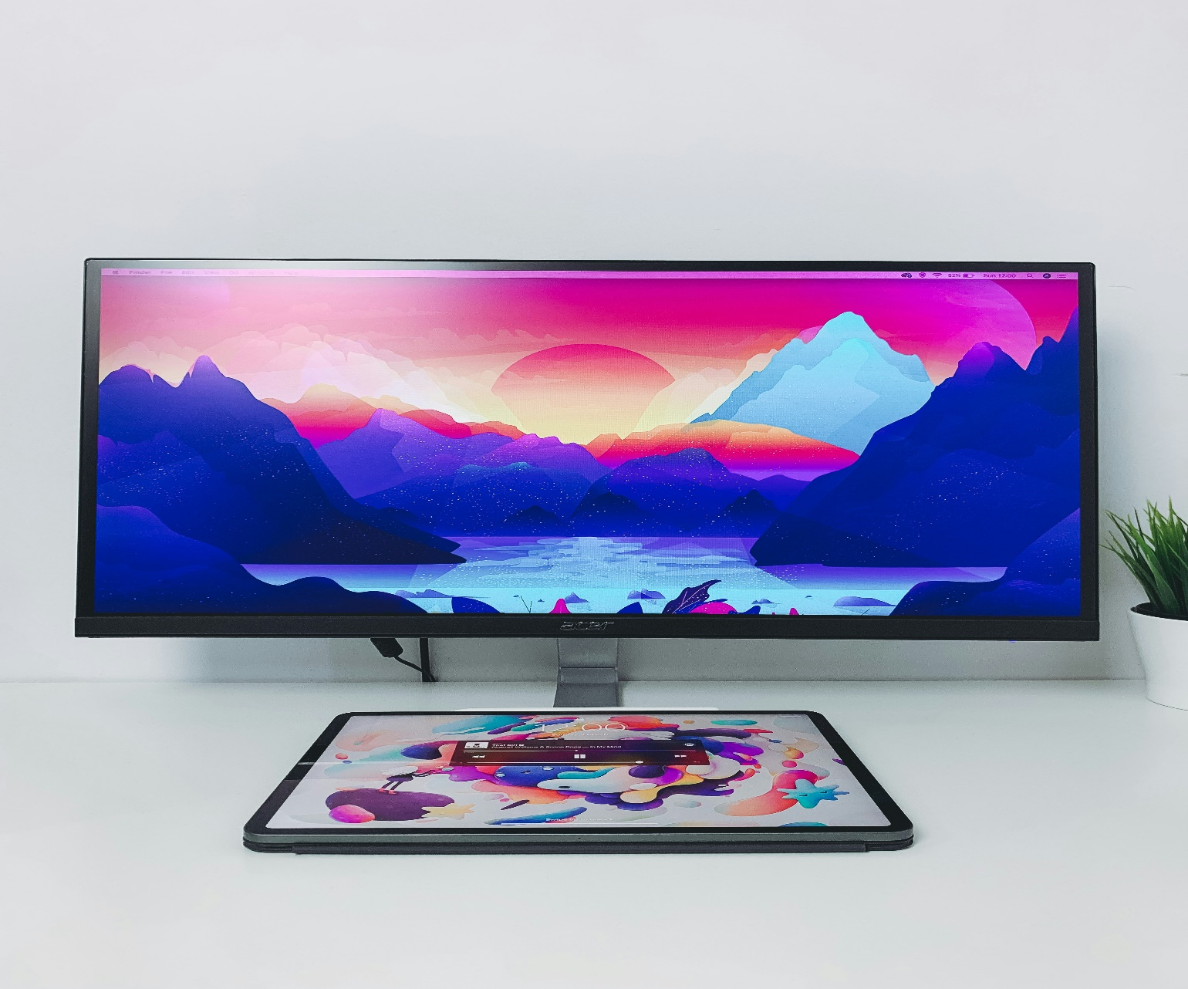
Module 4: Customizing WordPress Sites
Monitor
OUTPUT DEVICES
Creating and Managing Pages
Adding New Pages:
Using the block editor (Gutenberg)
Creating layouts with columns, images, and text blocks
Page Templates:
Understanding different page templates (full-width, no sidebar, etc.)
Customizing templates for specific needs
Menu Management:
Creating and organizing navigation menus
Adding pages, posts, and custom links to menus
Monitor, or display, is an output device that shows visual information generated by a computer.
It is any piece of computer hardware that receives data from one source and converts it into another form.
It is also a computer equipment that convert information into a human-perceptible form.
It provides a visual interface for users to view applications, documents, videos, and more.

Slide 15
Creating and Managing Posts
Difference Between Posts and Pages:
Posts are for blog entries, Pages are for static content.
Categories and Tags:
Organizing posts using categories and tags
Featured Images and Excerpts:
Adding visual appeal to posts with featured images
Writing summaries using excerpts

Slide 16
Widgets and Sidebars
What are Widgets?:
Small blocks that add functionality to sidebars and footers.
Common Widgets:
Recent Posts, Categories, Search, Social Media Links
Customizing Sidebars:
Adding and arranging widgets in sidebars and footers

Slide 17
Hands-On Practice: Customization
Task: Create a homepage and blog page, customize the sidebar with widgets, and organize the navigation menu.

Slide 18
Module 5: SEO and Performance Optimization
WordPress SEO Basics
Using Yoast SEO Plugin:
Setting up the plugin
Optimizing posts and pages for SEO
Configuring sitemaps and social media settings
Optimizing Content for Search Engines:
Keyword usage, meta descriptions, and alt text for images
Creating SEO-friendly URLs (permalinks)
Mobile Optimization:
Ensuring the site is responsive and mobile-friendly
Testing site performance on different devices

Slide 19
Performance Optimization
Importance of Site Speed: Faster sites rank better and improve user experience.
Tools for Performance Optimization:
Caching plugins (e.g., W3 Total Cache, WP Super Cache)
Image optimization (e.g., Smush, ShortPixel)
Database optimization
Using a CDN (Content Delivery Network): Speeding up site delivery by using networks like Cloudflare.

Slide 20
Security Best Practices
Securing WordPress Sites:
Using strong passwords and two-factor authentication
Regular backups with plugins like UpdraftPlus
Keeping WordPress, themes, and plugins up-to-date
Protecting Against Malware:
Installing security plugins (e.g., Wordfence, Sucuri)
Scanning the site for vulnerabilities

Slide 21
Hands-On Practice: SEO and Performance
Task: Set up Yoast SEO, configure performance settings, and optimize your WordPress site for speed and security.

Slide 22
Final Project
Project Overview:
Objective: Create a fully functional WordPress website that demonstrates the skills learned in the course.
Components:
1. Install and set up WordPress on a hosting account.
2. Choose and customize a theme.
3. Create pages, posts, and menus.
4. Install and configure essential plugins.
5. Optimize the site for SEO and performance.
6. Implement security best practices.

Slide 23
Thank you for being part of this session! With the power of WordPress, you're now ready to create and manage dynamic websites with ease. Happy building!
Website : www.tsindamedia.com
Tel : +250 798 873 226

